Slide 1

A Journey to the Future
Reisebüro Reis

Slide 2
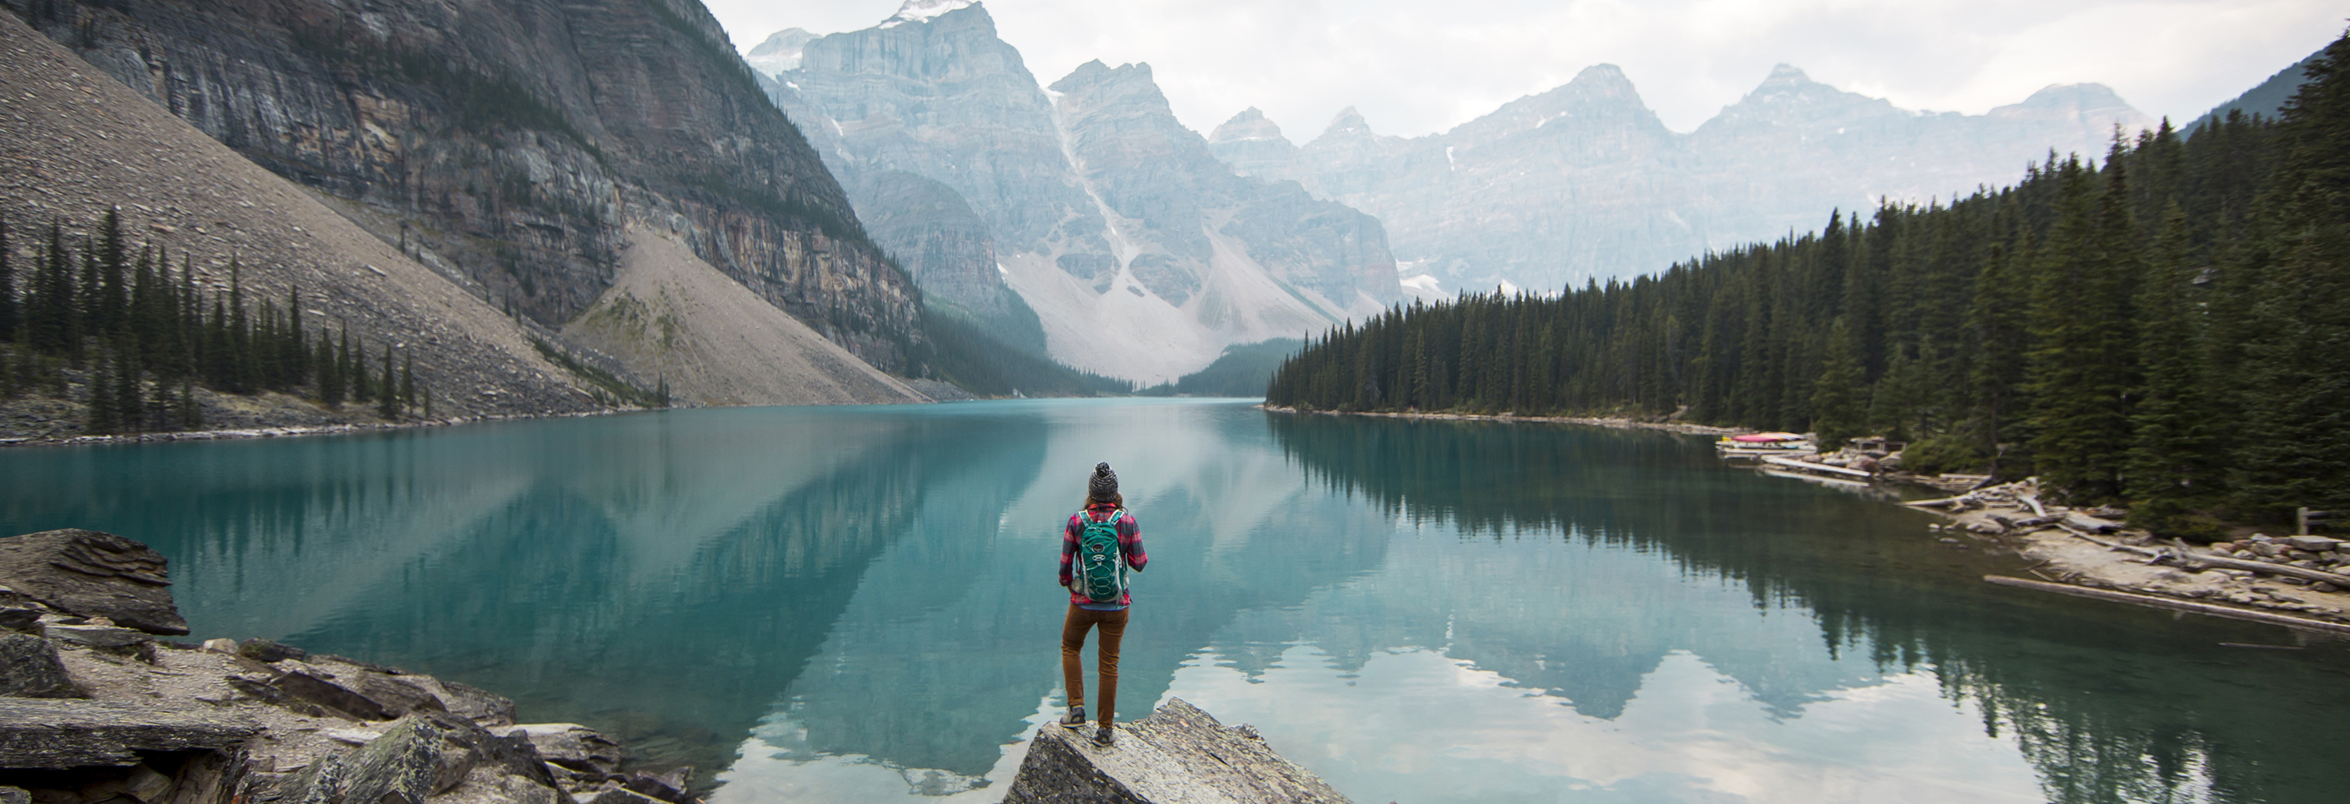
Agenda for
Today
A Journey to the Future
01
02
03
Introduction
Storyline
Our Approach
Welcome, Meet the Team
Our Journey to the Future
Roadmap of the Project
04
05
UI
API
Mockup, UML, Demo
Idea, Demo

Slide 3
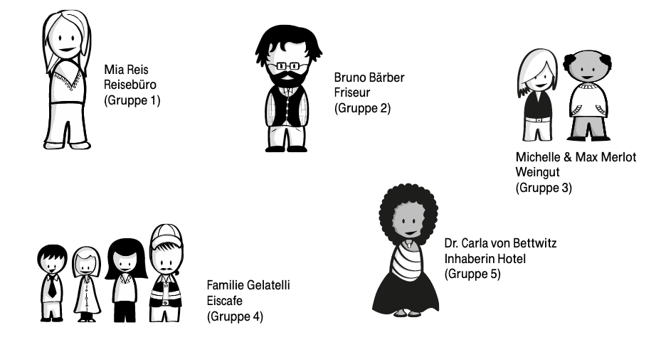
Welcome to “Völkerswalden an der Südlichen Weinstraße”
Mia Reis
Michelle & Max Merlot
Travel Agency
Fibre Optic Cable
Winery
for the 2.000 citizens
Digitalization
How can we help digitalize the local jobs?
Where can software be utilized?
How can the locals work together?
And where can interfaces be used?
Bruno Bärber
Dr. Carla von Bettwitz
Barber
Familie Gelatelli
Hotel Owner
Let’s start
Ice-Cream Shop

Slide 4


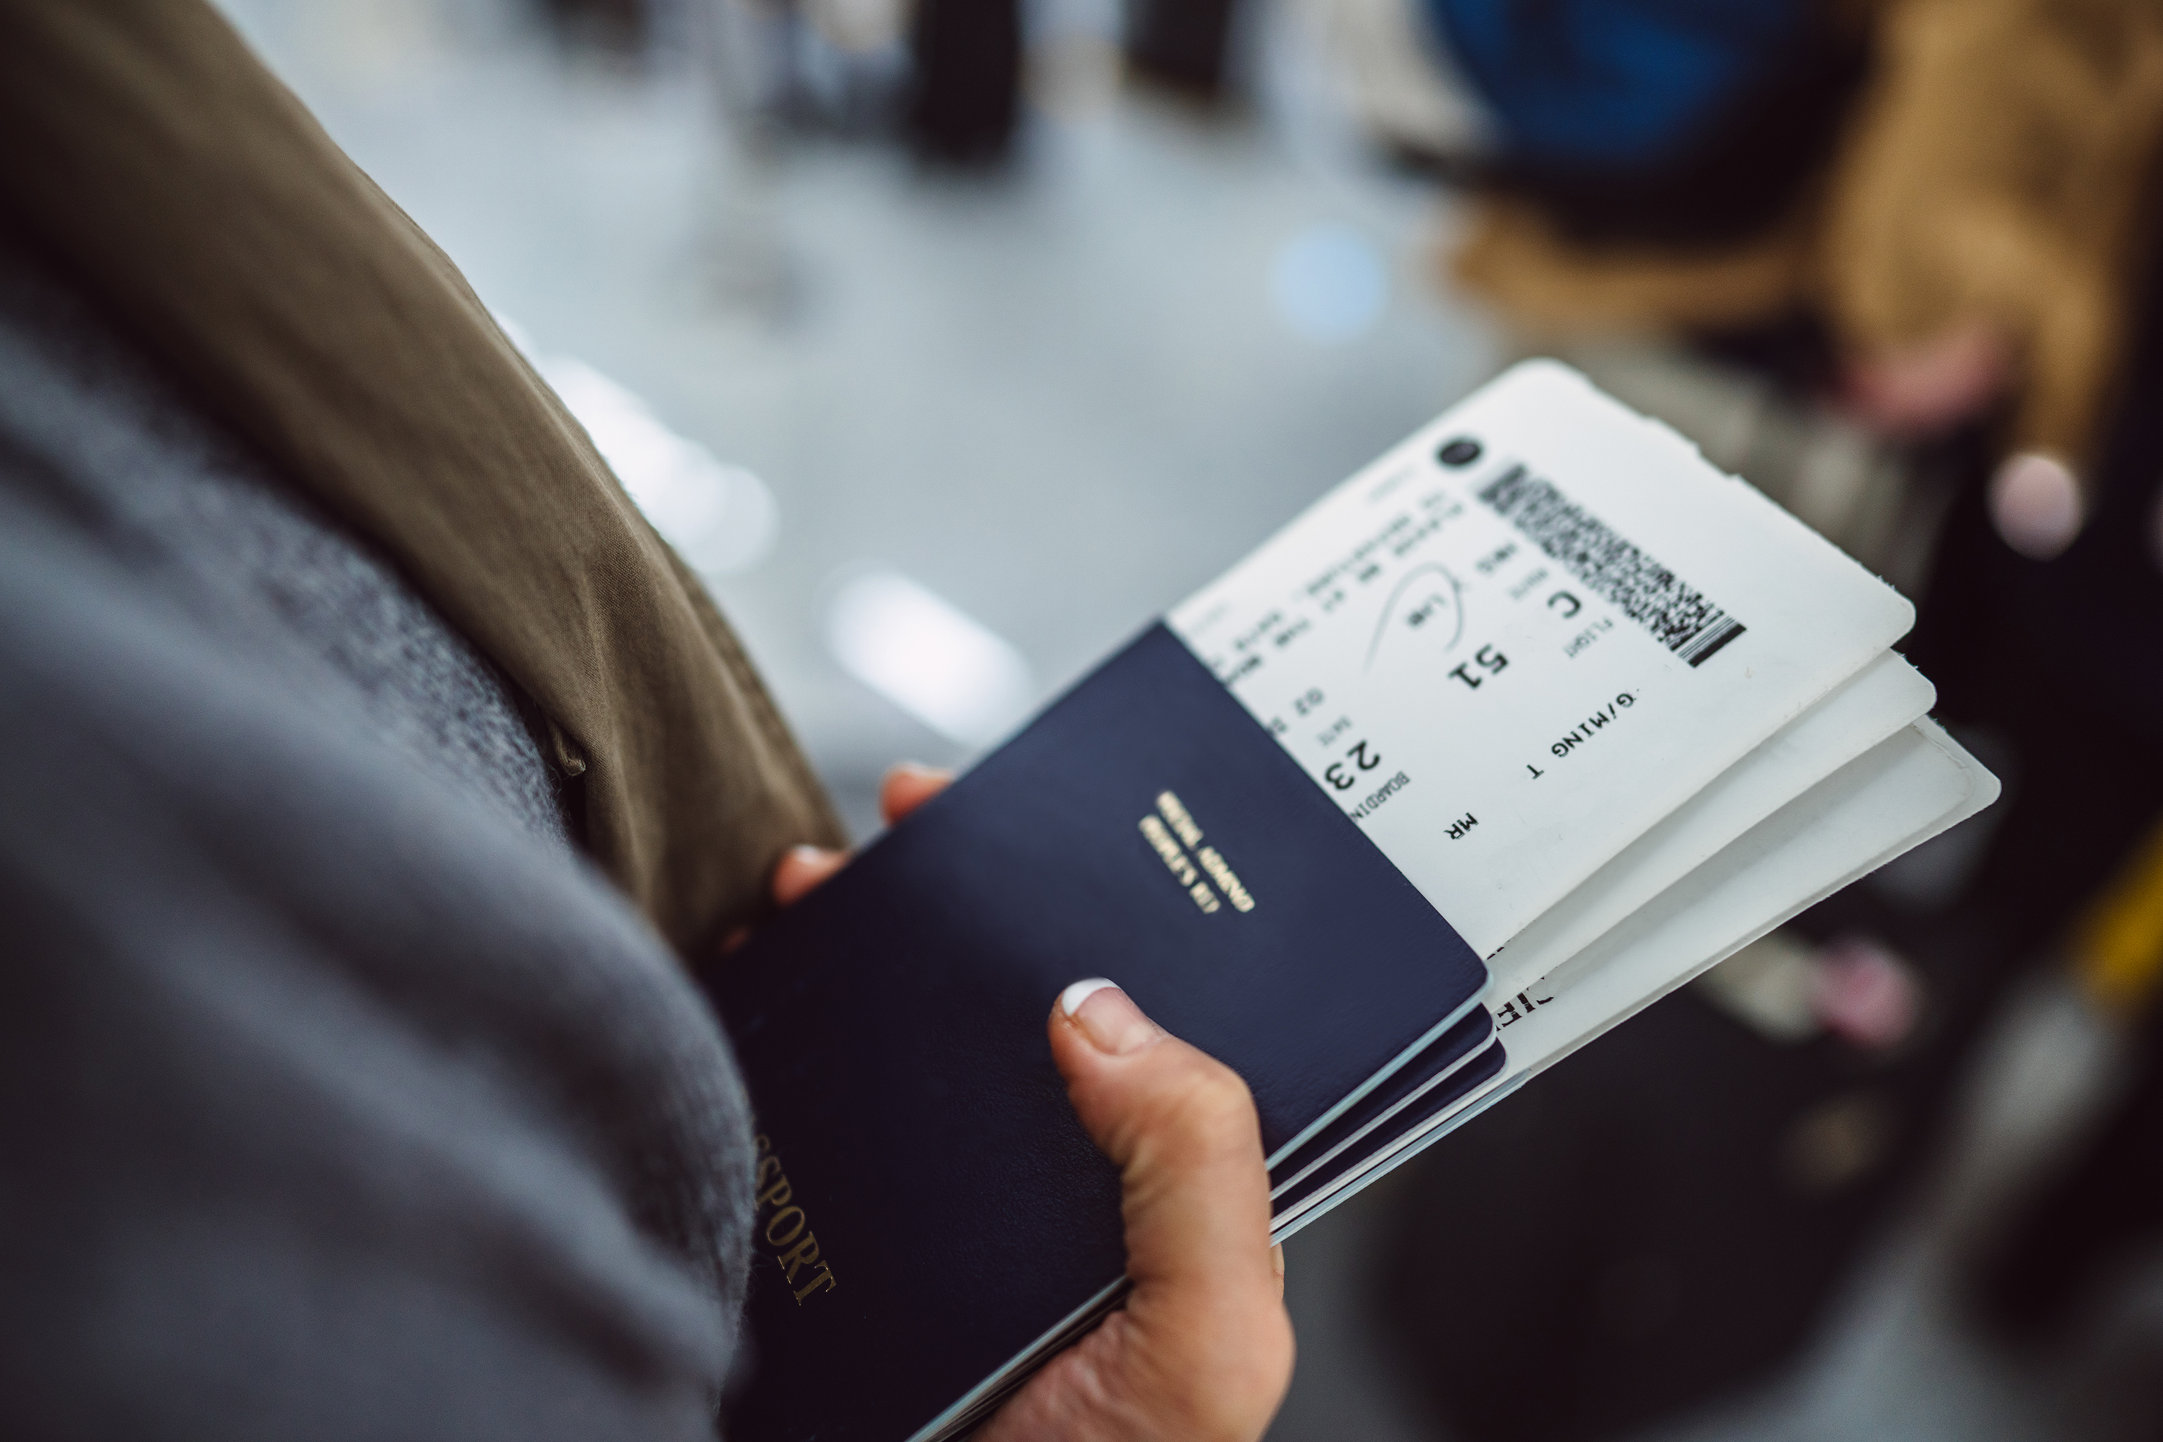
Reisebüro
Reis
A Journey to the future

Slide 5
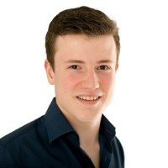
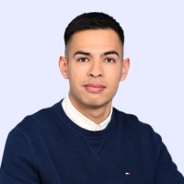
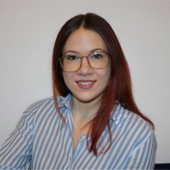
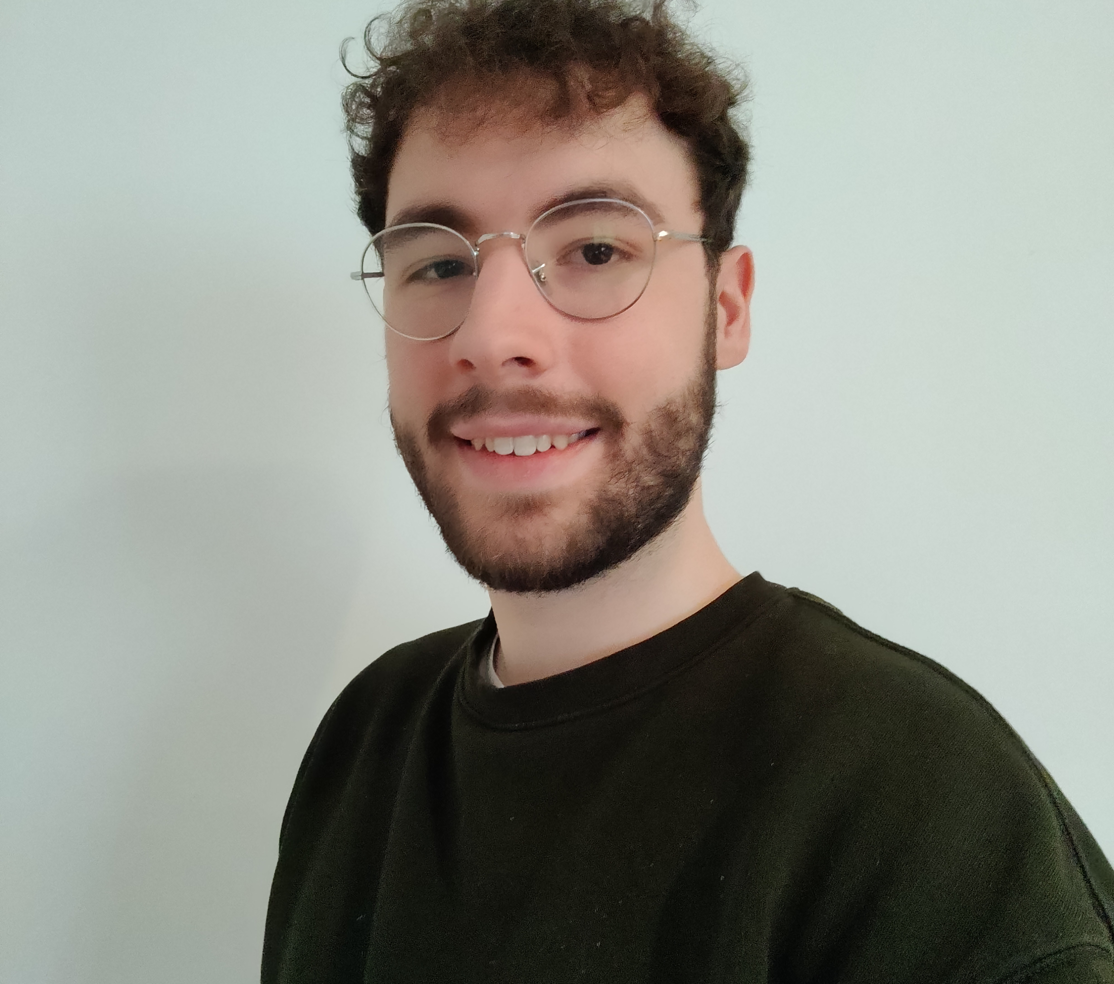
Meet the
Team
Contributors to the project
Cedrik Baedorf
Backend Developer, SAP
Florian Veitz
Backend Developer, SAP
Anna Gossner
Frontend Developer, BASF
Jonas Becker
Frontend Developer, BASF

Slide 6

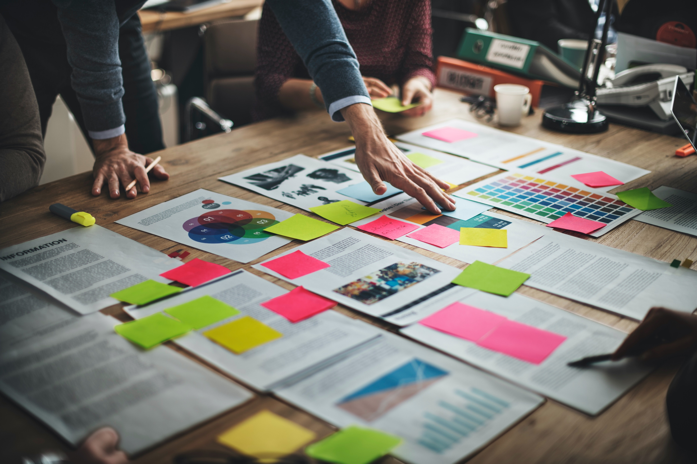

Storyline
Join us on our journey to the future

Slide 7
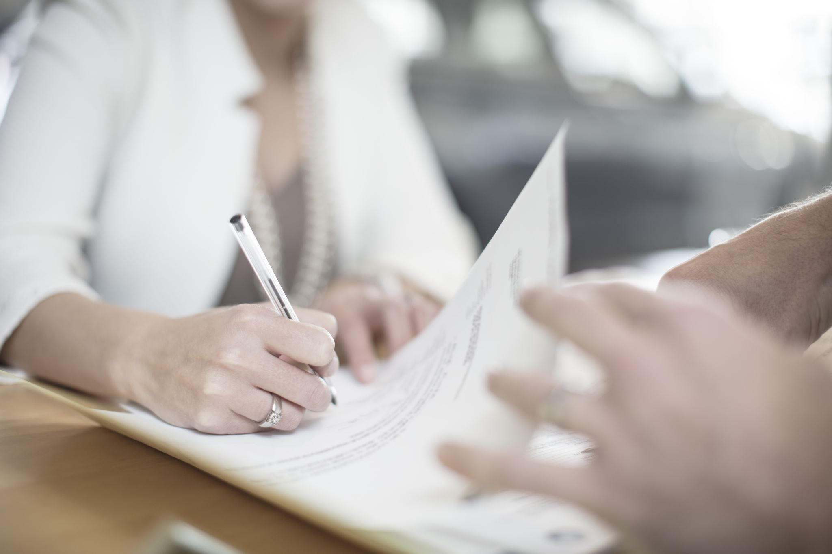

T R A V E L
Digital Solution
What problems get solved through the software for Mia Reis and her employees?
Before:
Now:
Paper-work
One System
A lot of it.
Everything in one place.
Digitalized.

Slide 8
Improvements for the Travel Agency
Sustainable
Efficient
Sustainability
Flexibility
No more paperwork
Customer wishes can be changed quickly
Flexible
Efficiency
Satisfaction
As a result of optimized working processes
Satisfied employees, as well as customers
Satisfactory
Notes:
Allows remote work

Slide 9



Our Approach
How did we turn our ideas into code?

Slide 10
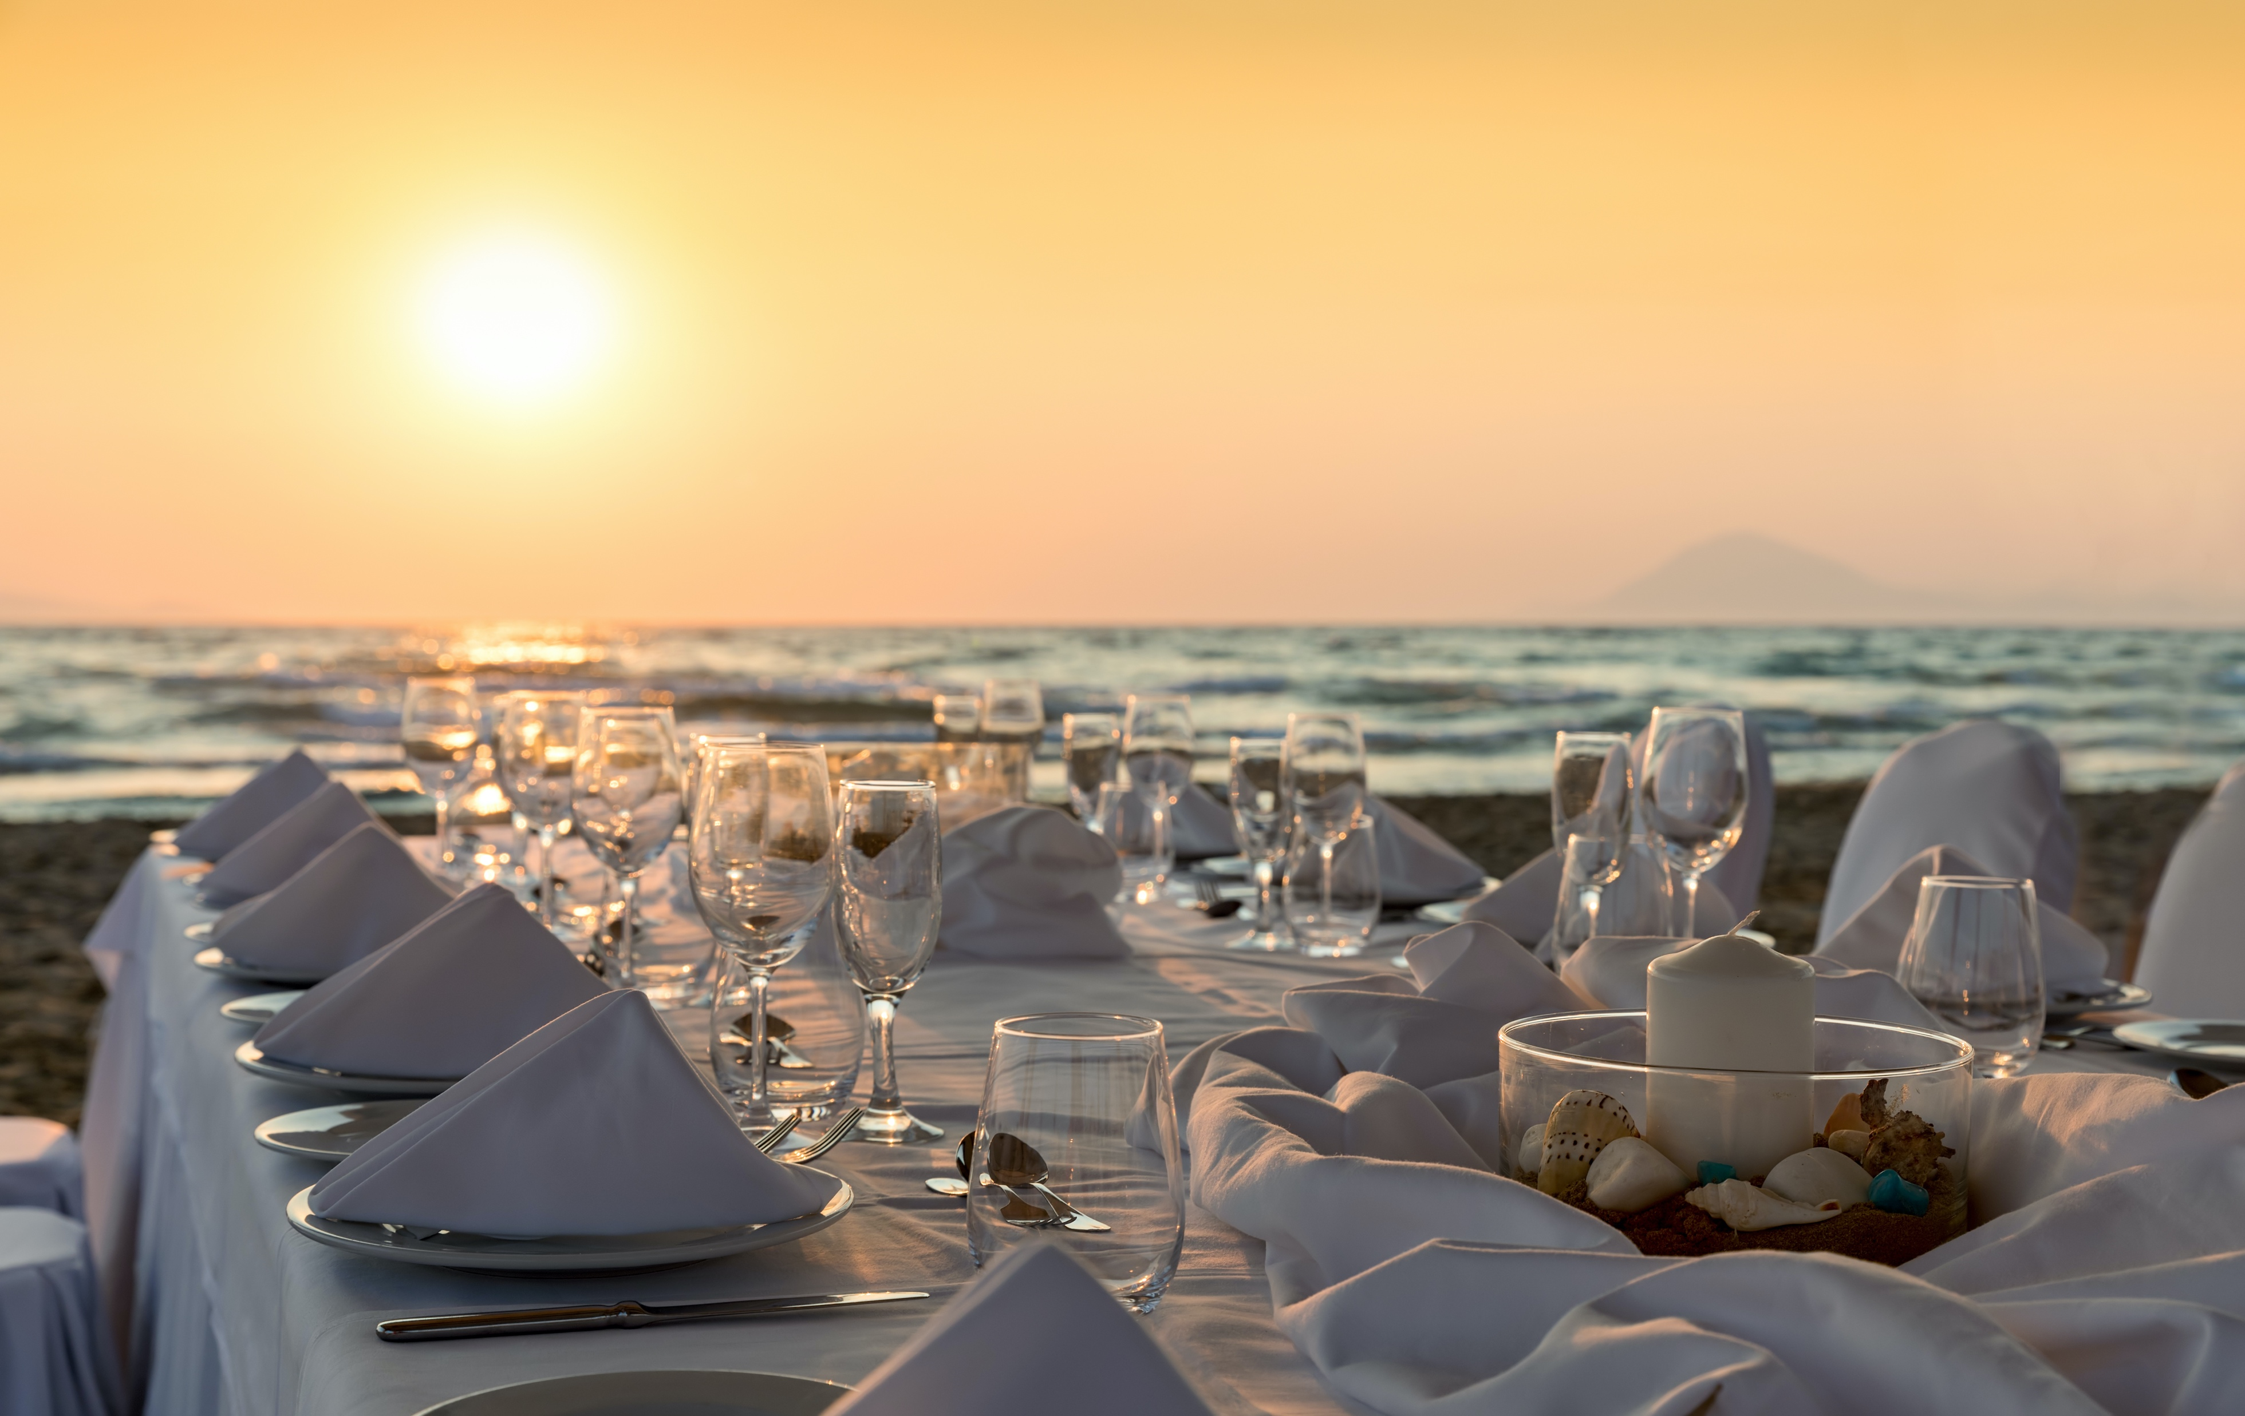

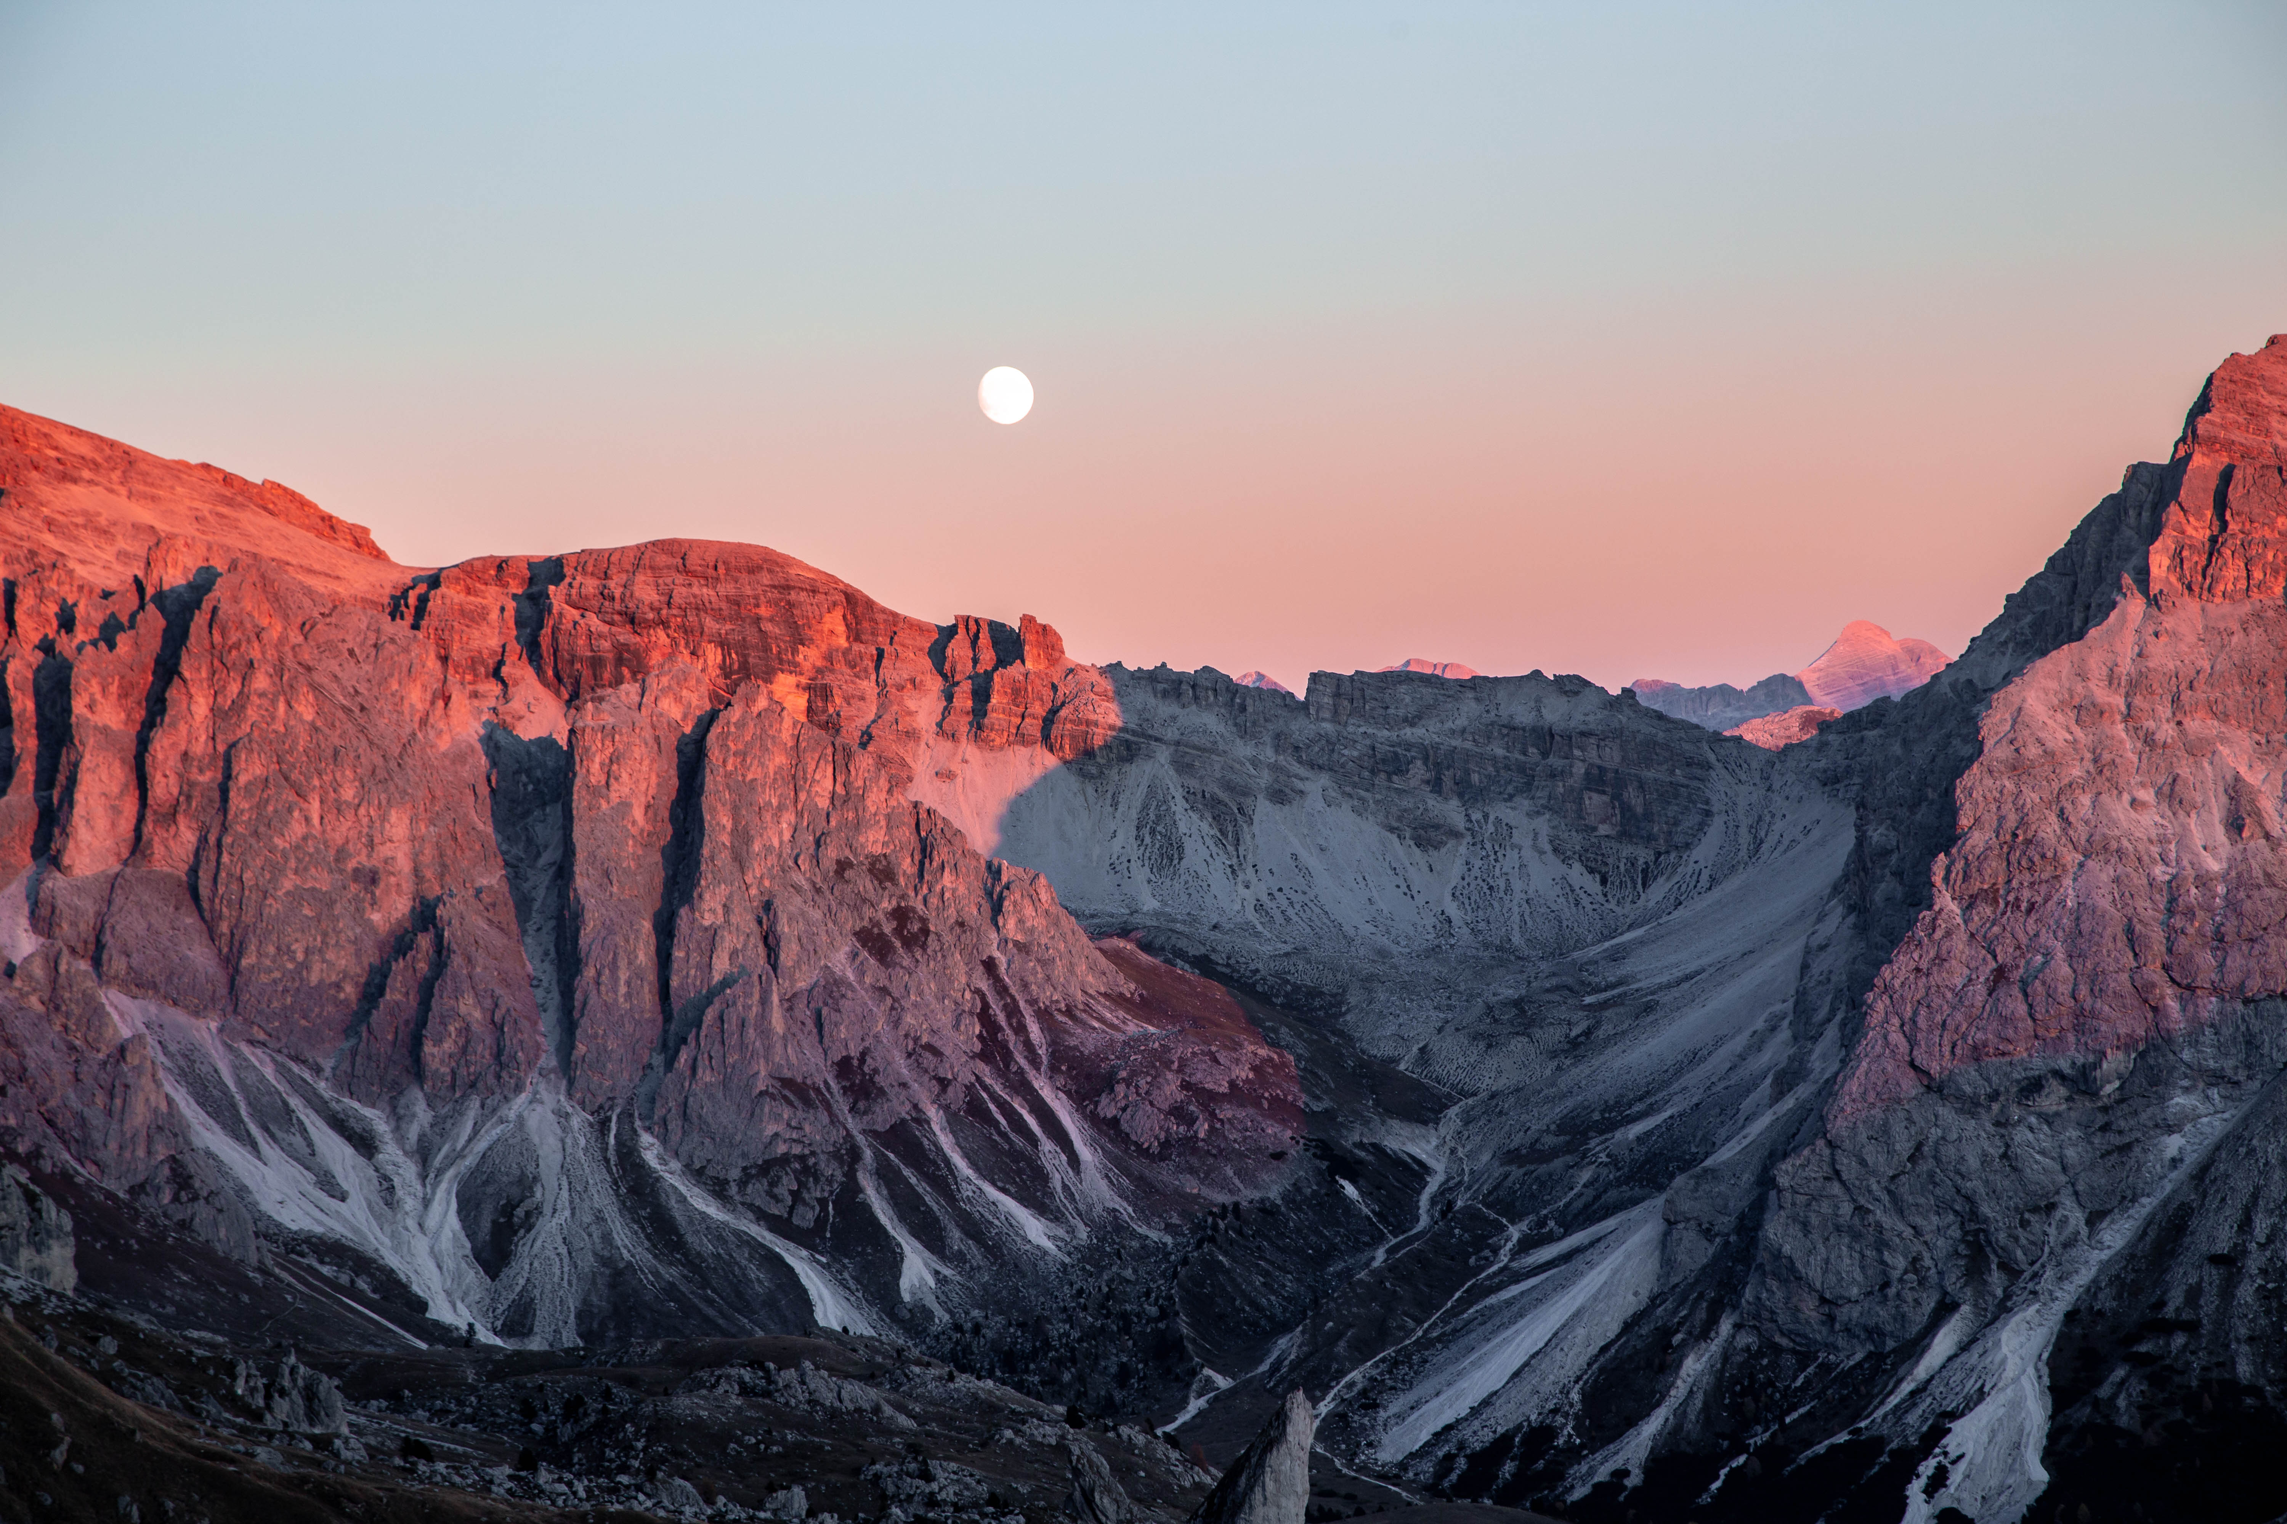
Idea
Collecting ideas for the software:
Who is it for?
What processes should it include?
Brainstorming about interfaces & possible connections
Setting up a GitHub repository
Division of tasks
01
Modeling
02
Use Case Diagram
Use Case Documents
Class Diagram
Entity Relationship Model
Our
Journey

Slide 11


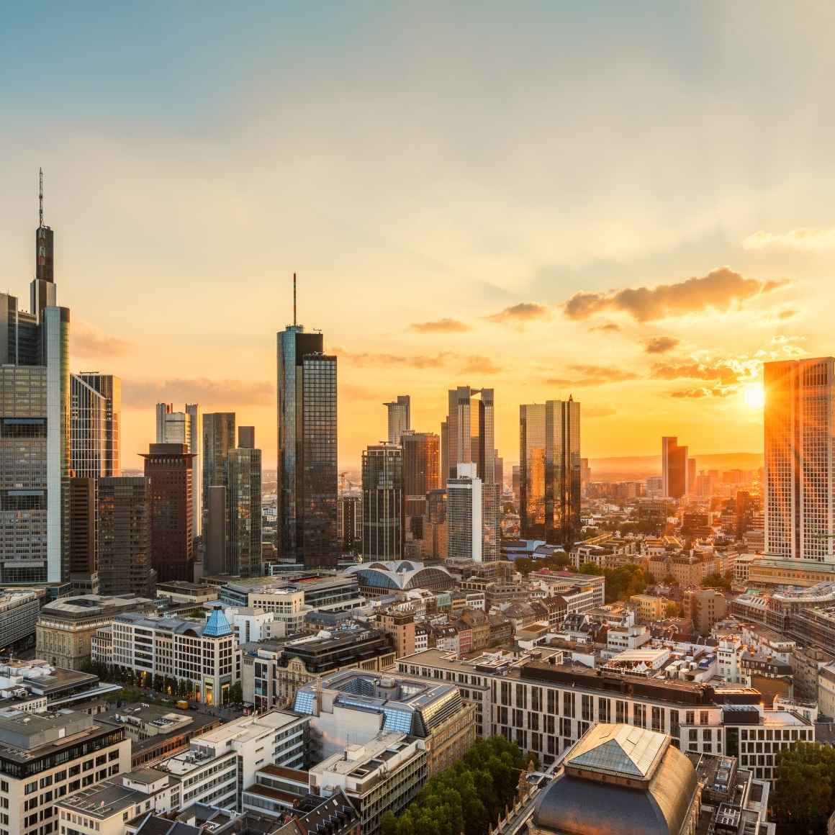
Mockup
Designing a mockup for the different use cases,
as well as alternative flows & errors
Programming
JPA Entities
Junit Tests
Frontend: JavaFX
Backend
03
Backend
Database
Server
API
04

Slide 12
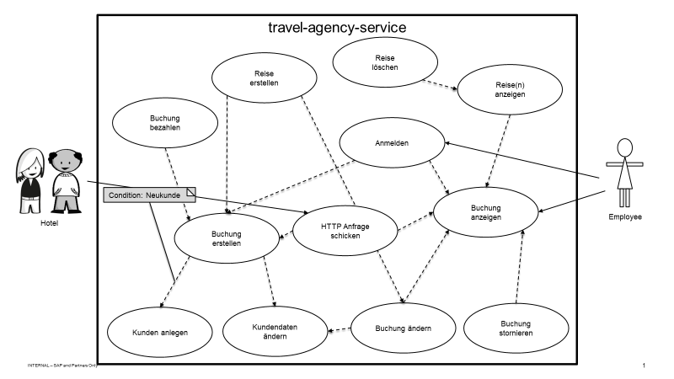
Use Cases

Slide 13



UI
User Interface
Mockup, Database Model and Demo

Slide 14
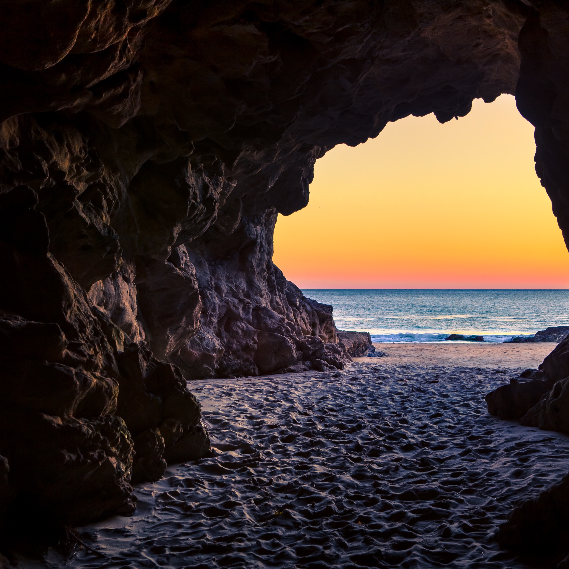

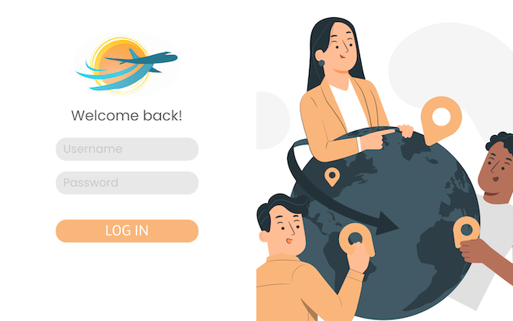
UI Mockup Demo
Mockup

Slide 15
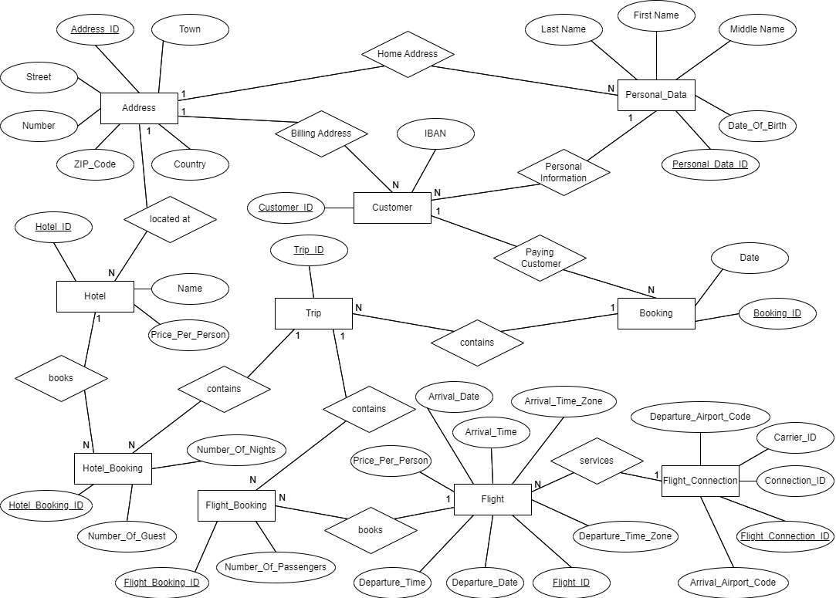
Database Model
Entities
Address
Personal data
Customer
Hotel
Hotel booking
Flight connection
Flight
Flight booking
Trip
Booking

Slide 16
Database Model
Entities
Address
Personal data
Customer
Hotel
Hotel booking
Flight connection
Flight
Flight booking
Trip
Booking

Slide 17
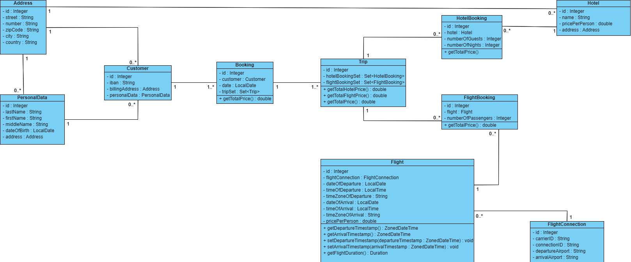
Database Model

Slide 18
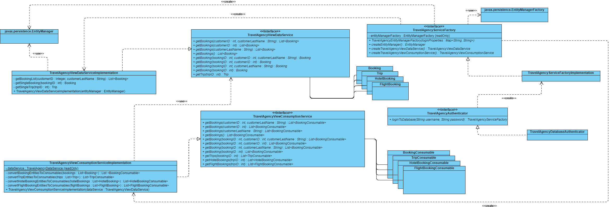
Service Architecture

Slide 19
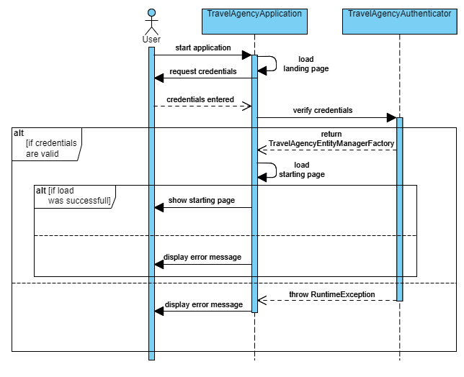
Login Process

Slide 20
Login Process

Slide 21
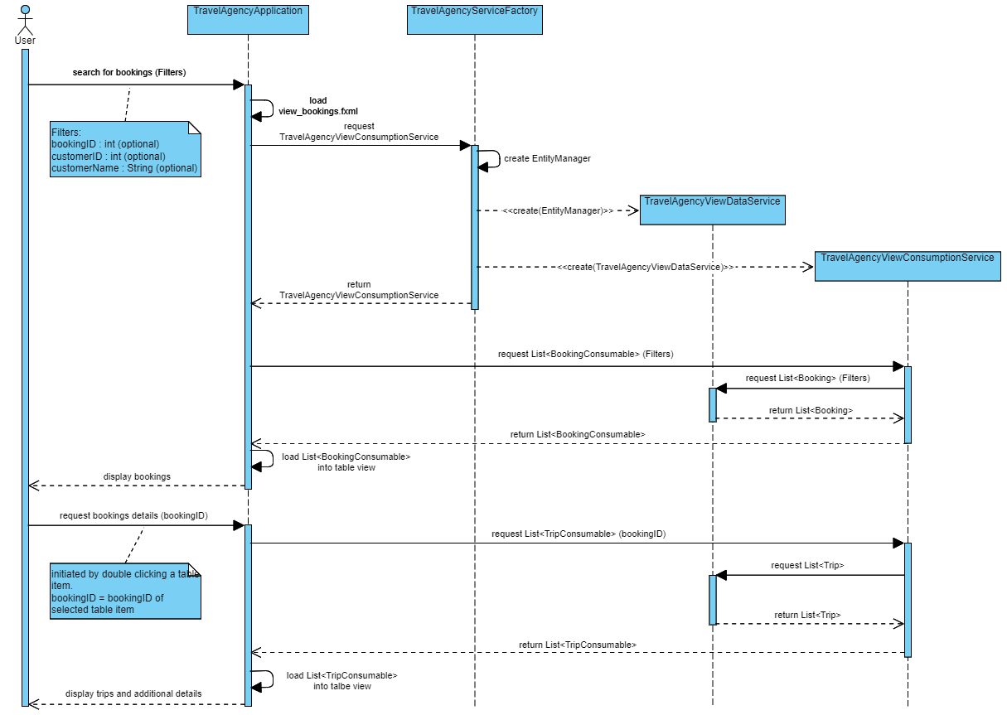
Service Process

Slide 22
Service Process

Slide 23
UI Demo

Slide 24
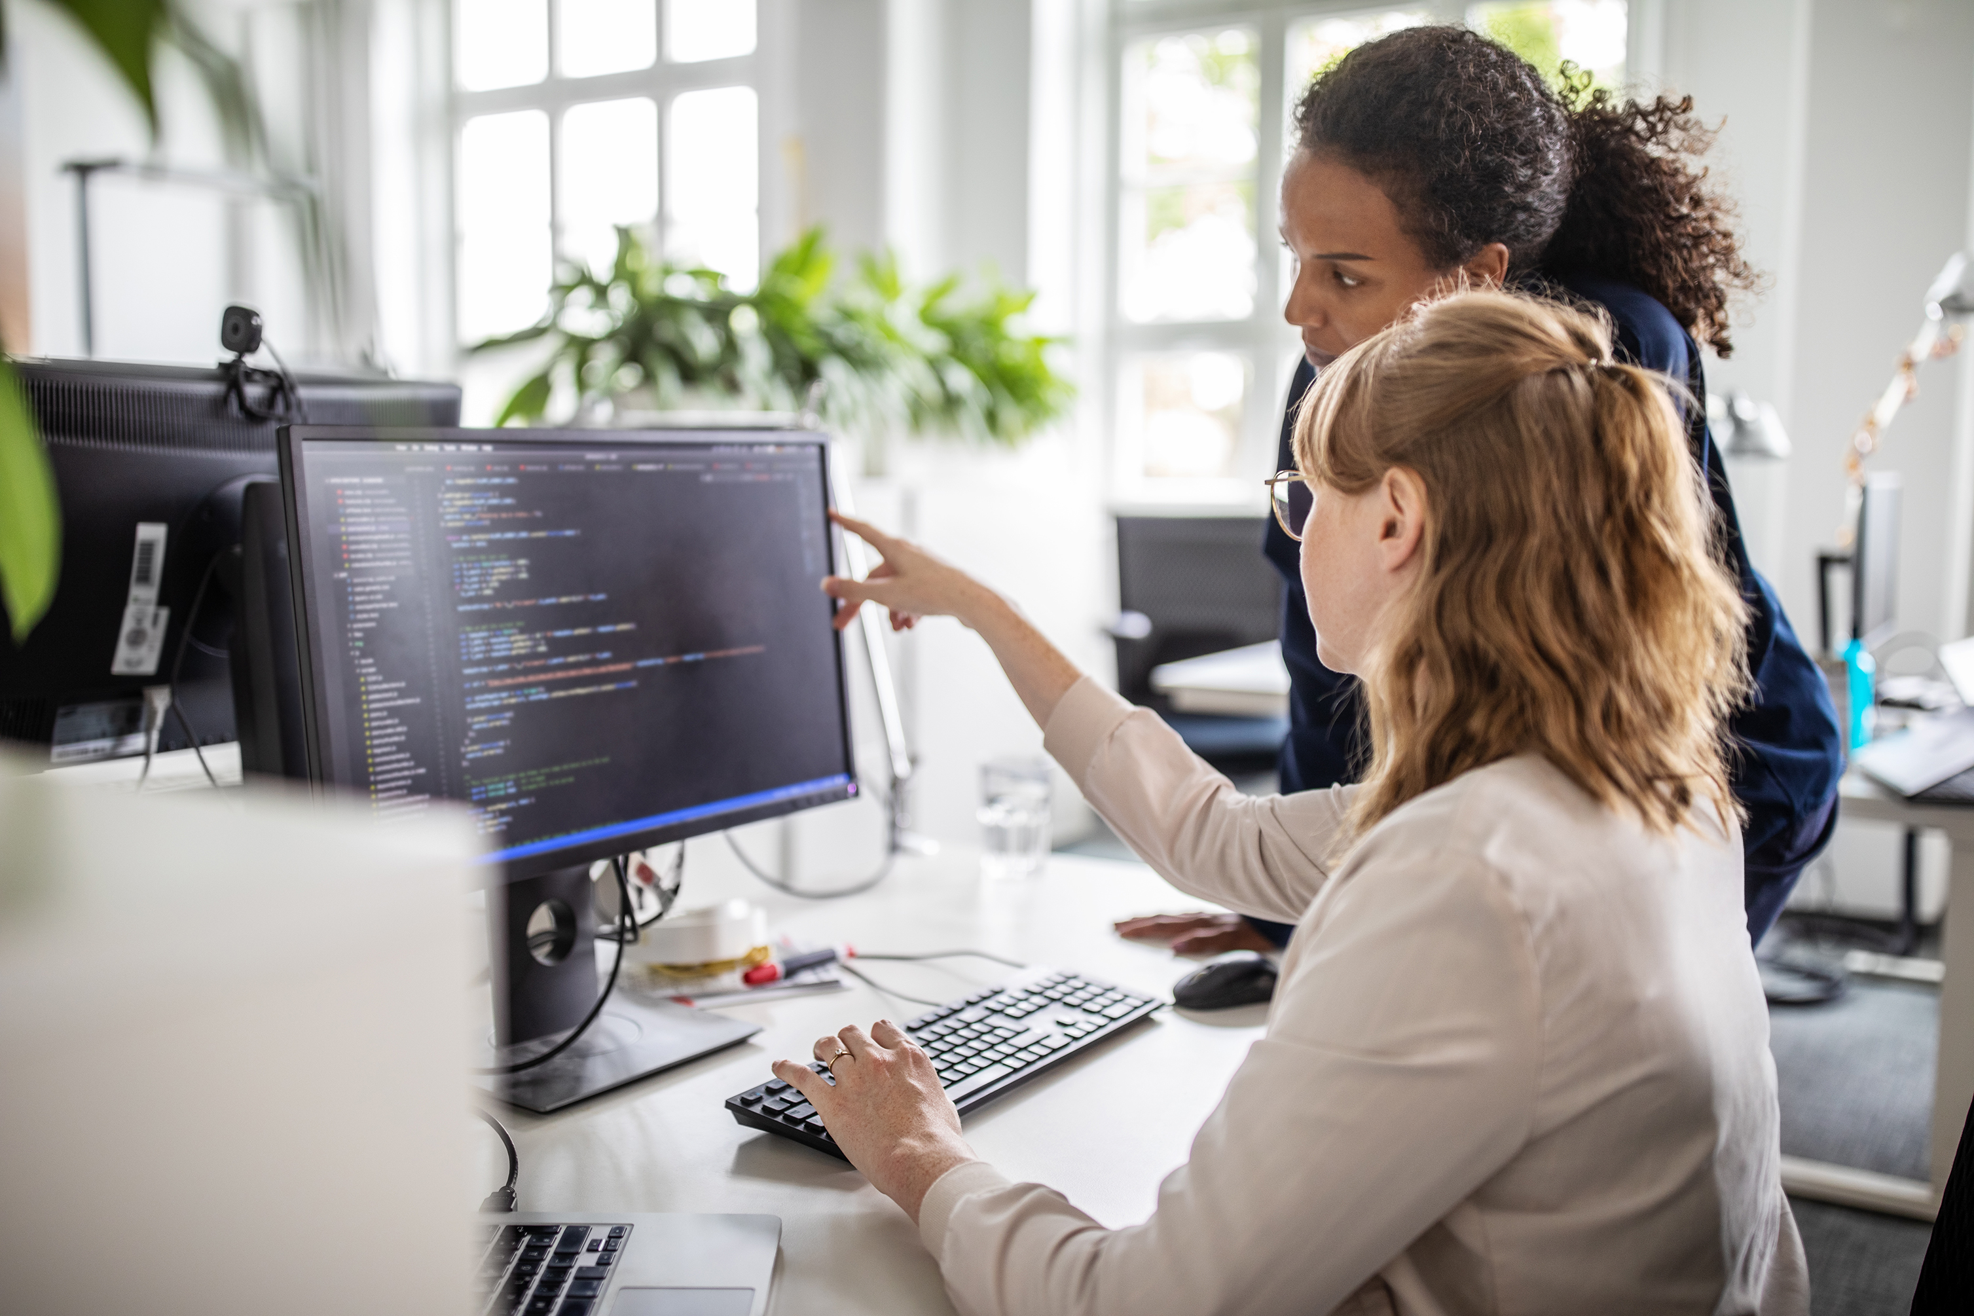


API
Application Programming Interface
API Ideas, Demo

Slide 25
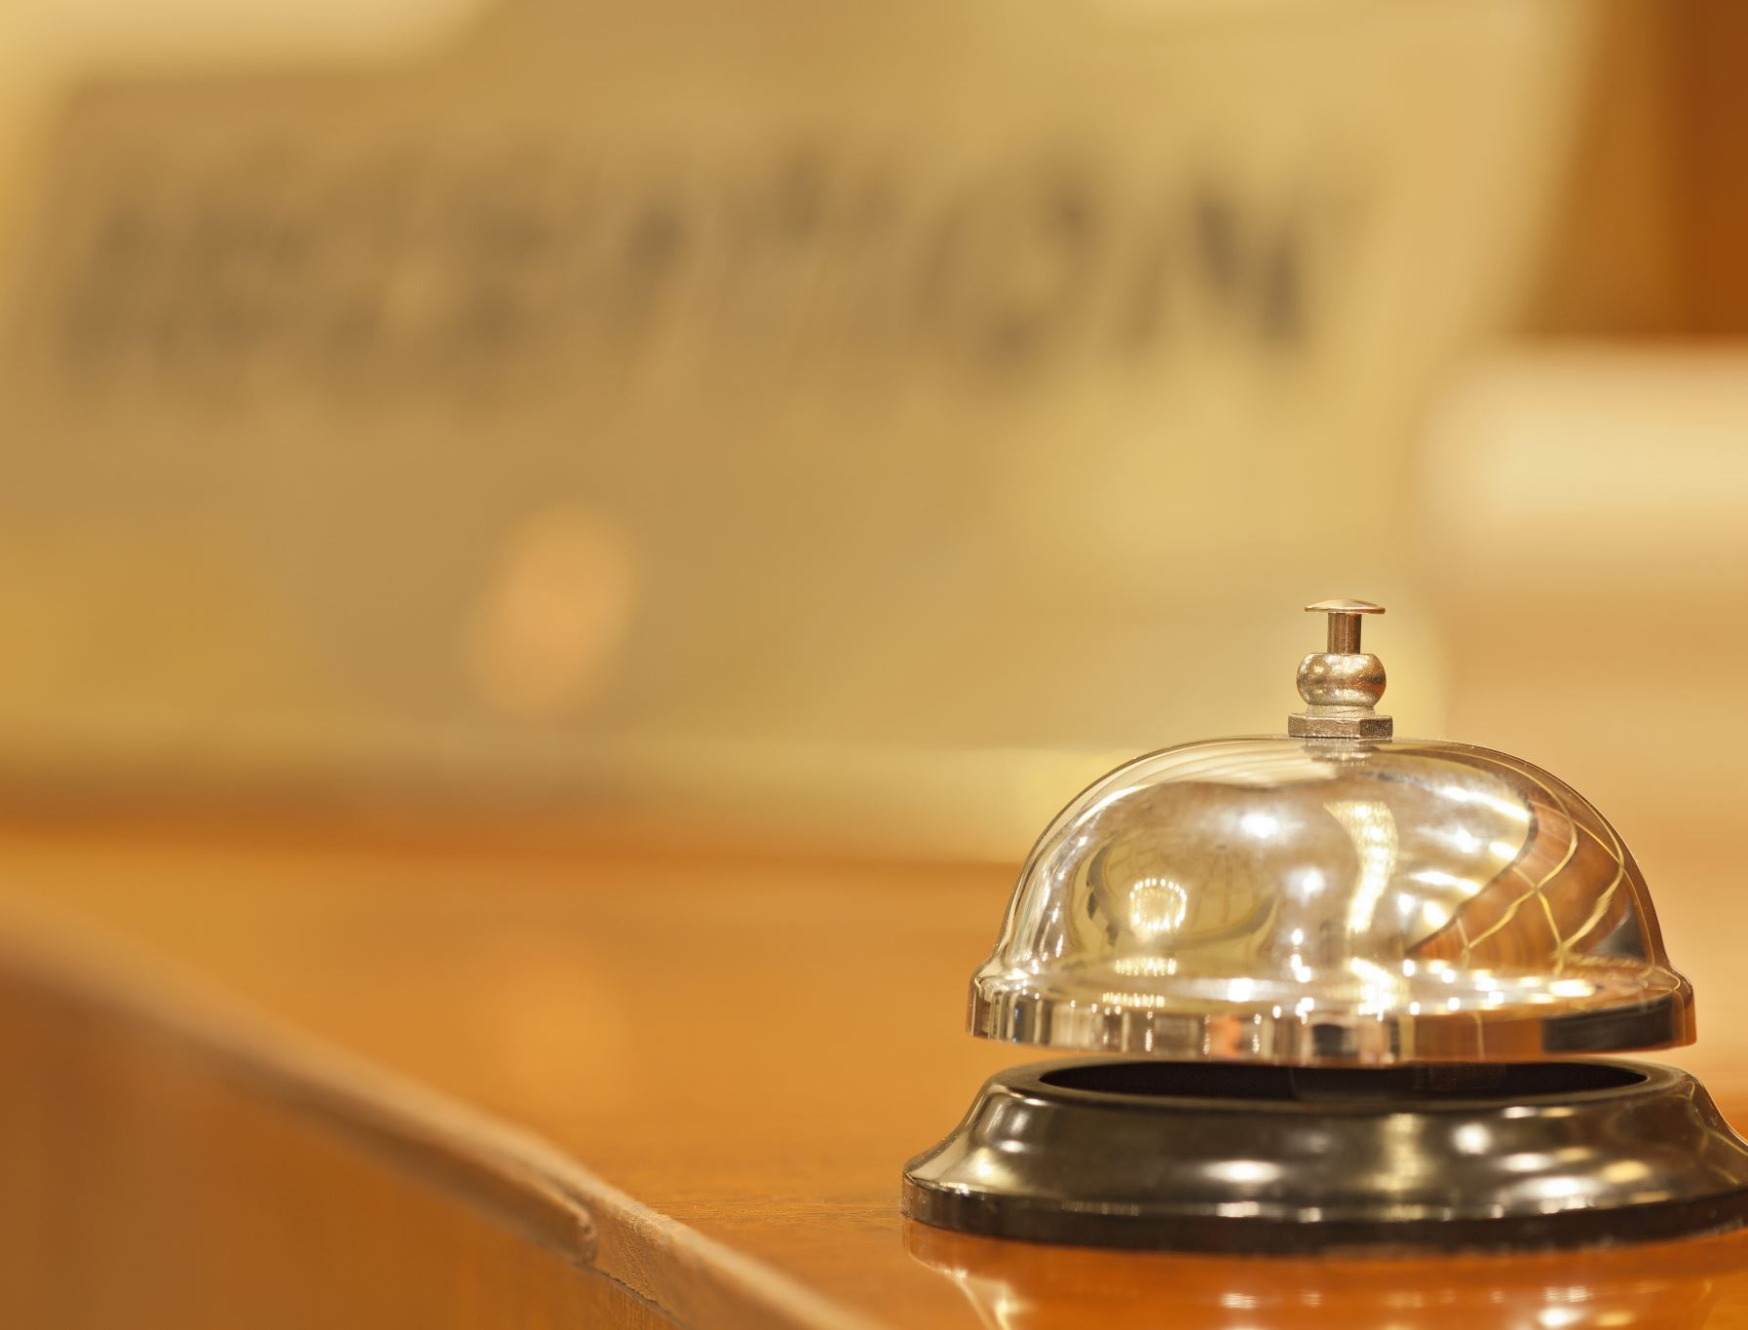


Building
Bridges.
Data exchange
Employees of the hotel can use the software to book flights & hotels for their customers. Third parties can use our API to benefit from our solution.
How can we adapt to a changing and more sustainable world?
By building bridges and leveraging the benefits of digital transformation.
Better service
For the customers & enterprises
Dr. Carla von Bettwitz
Shared system
Go to next
Hotel Owner
Shared data and platform

Slide 26
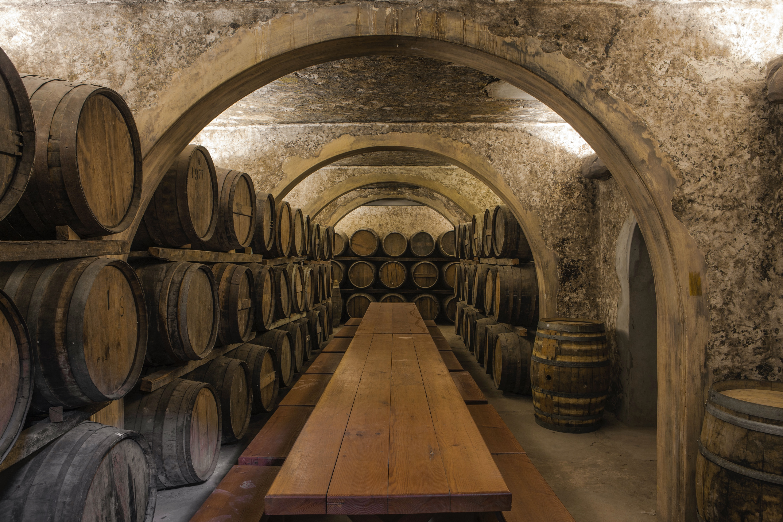

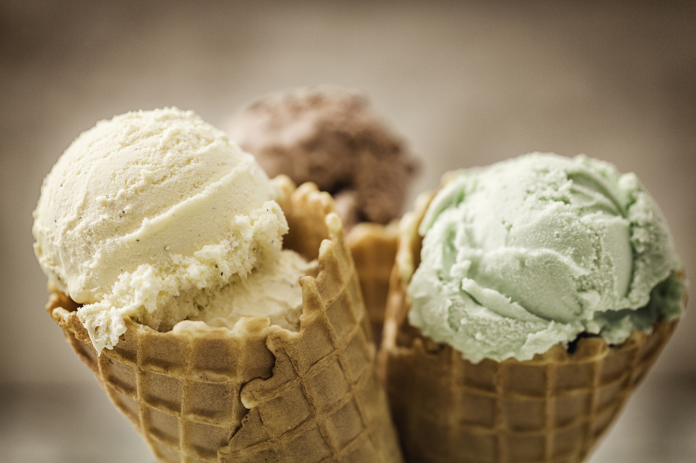

Other Possible
Interfaces
Voucher Campaign
Every customer receives a voucher for either the ice-cream shop or the winery.
Support
Supporting the other local businesses
Customer Value
Michelle & Max Merlot
Increase of customer value and loyalty
Winery
Familie Gelatelli
Ice-Cream Shop

Slide 27
API
Demo
Start

Slide 28

Thank you
for
your
attention!
Any questions?

Slide 29
BACKUP

Slide 30
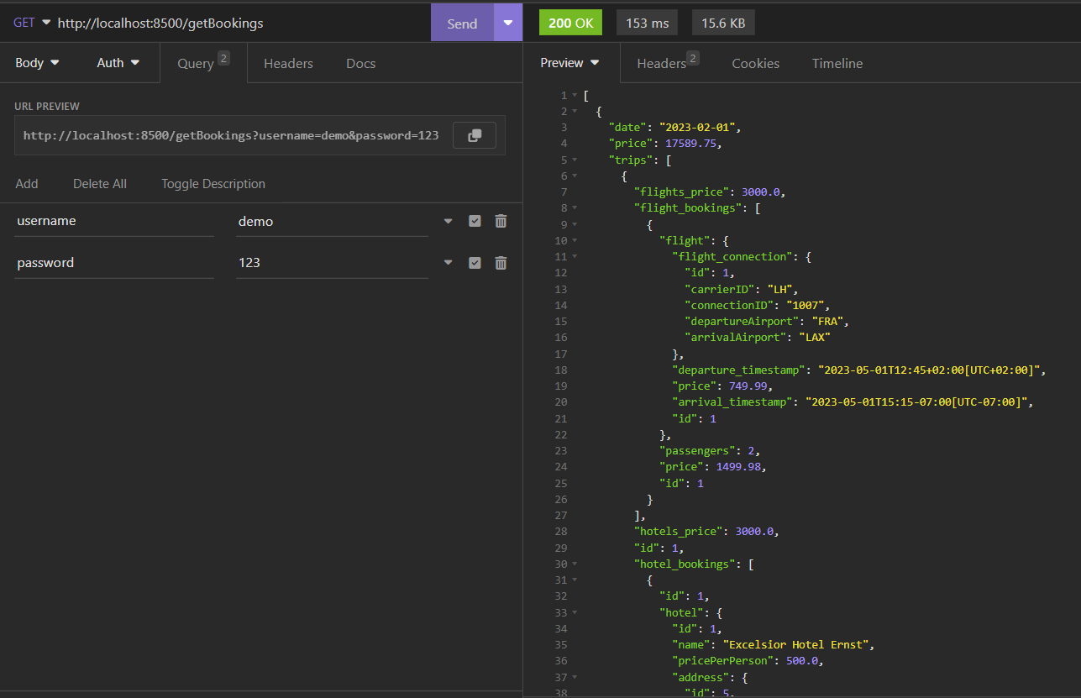

Slide 31
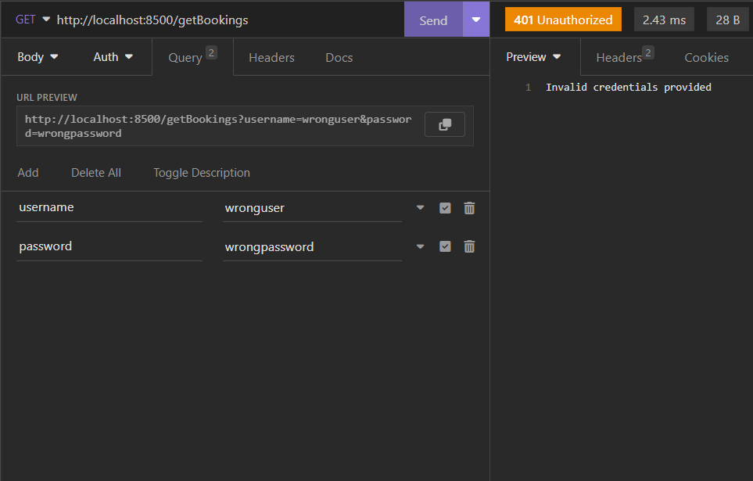

Slide 32
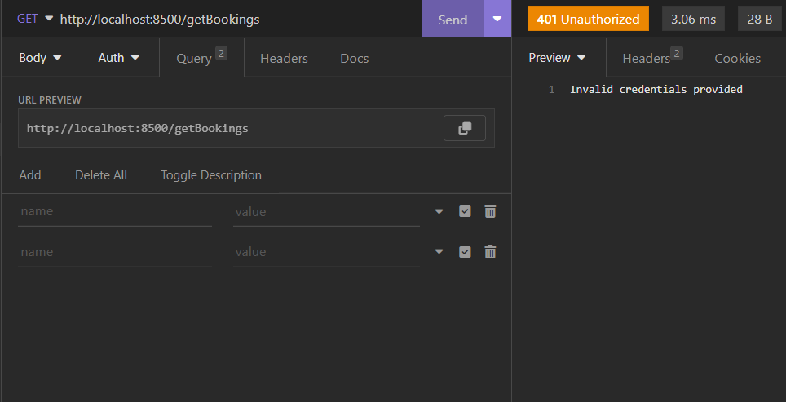

Slide 33
